Slide 1


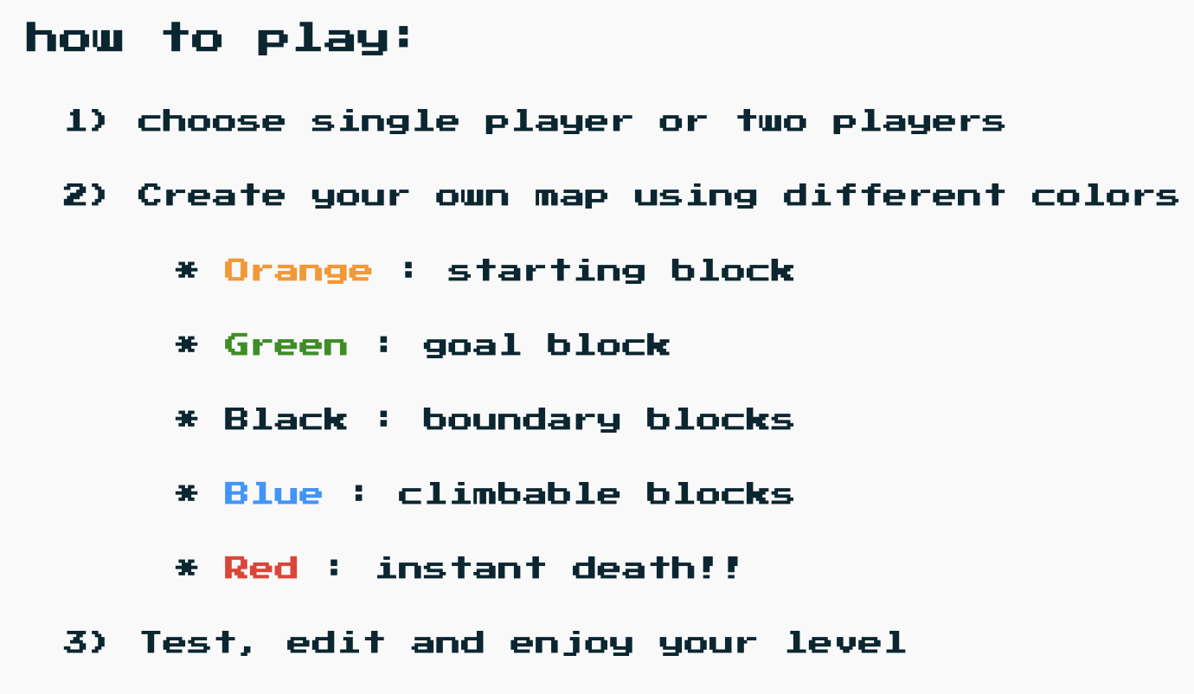


Slide 2
CONGRATULATIONS!
You completed this level
Would you like to:
Replay
level
Create
new
level

Slide 3
Choose the number of players
Single Player
Two Players
* One Character
* Use WASD keys
* Two Characters
* Pink player uses WASD keys
* Purple player uses arrow
keys
To Level
Builder
To Level Builder

Slide 10


